Slide 1
Online GPS II/MAPP
Meetings 1 – 10

Slide 2
Meeting 3 Losses and Gains: The Need to Be a Loss Expert

Slide 3
License Rights to OCFS
Center for Development of Human Services, Institute for Community Health Promotion, SUNY Buffalo State acknowledges the State of New York’s and the Office of Children and Family Services’ royalty-free, non-exclusive and revocable license to reproduce, publish, distribute, or otherwise use any and all material herein for the limited purpose of training GPSII/MAPP Leaders and for as long as such materials and such training are deemed appropriate by NYS OCFS.
The Children’s Alliance of Kansas (CAOK) is the current national owner of the copyrighted “toolbox” of MAPP programs. NYS Office of Children and Family Services (NYS OCFS)/Center for Development of Human Services (CDHS) has permission from CAOK to provide MAPP programs (GPSII/MAPP, Caring For Our Own, Deciding Together, Shared Parenting, Mini-MAPP, and Child Sexual Abuse) to certify leaders through leader certification workshops and directly to foster/adoptive parents in New York State.
In order to better meet the needs of children and families in New York State, PS-MAPP was revised in 2004 and renamed GPSII/MAPP. Further revisions were made in 2005 after considering the feedback from MAPP Leaders throughout the state, and minor revisions and reformatting occurred in 2009. Significant revisions to the content and updating to reflect best practice and legal changes in New York State were made and approved by NYS OCFS in 2012 for this edition.
© 2009 Children’s Alliance of Kansas. Revised with permission NYS OCFS.

Slide 4
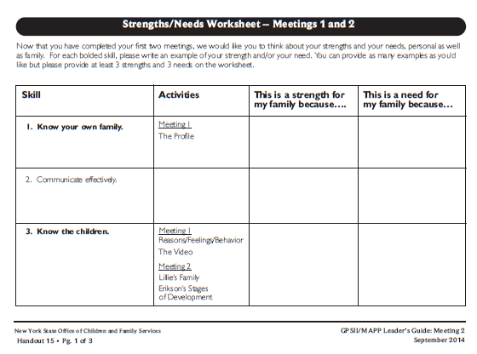
Roadwork from Last Meeting:
Meeting 2 Handout 15: Strength/Needs Worksheet

Slide 5
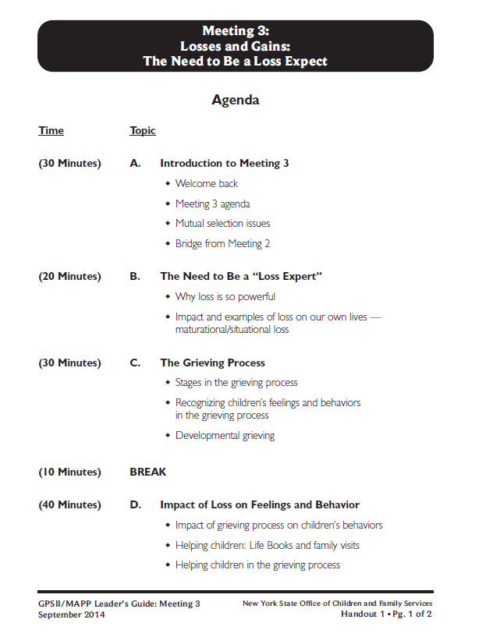
Let’s look at: Handout 1

Slide 6
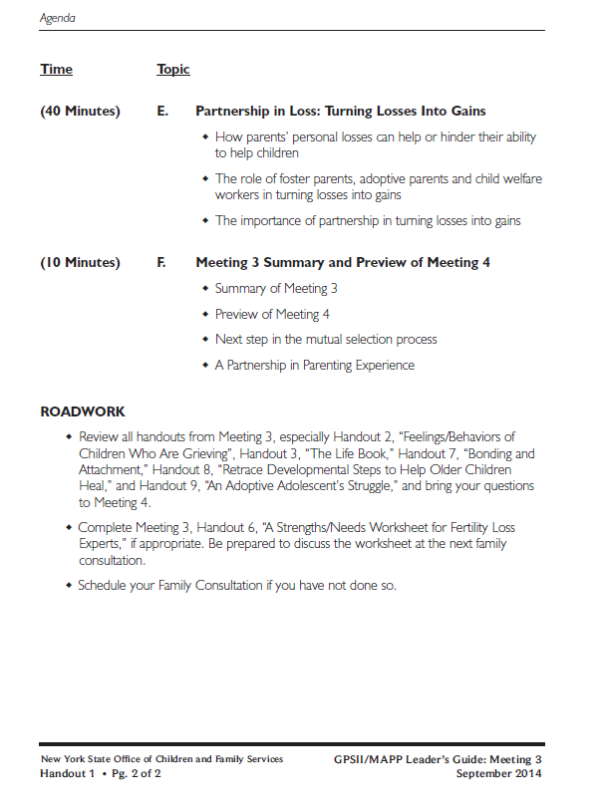

Slide 7
Maturational Losses
Orderly
Planned
Expected

Slide 8
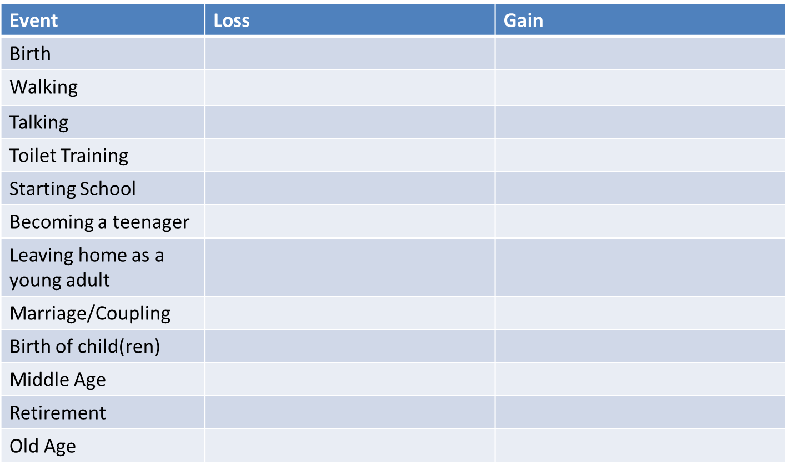
Maturational Losses

Slide 9
Situational Losses
Unplanned
Unexpected

Slide 10
Situational Losses

Slide 11
Foster Care, Reunification and Adoption
Maturational Loss
Planned
Expected
Situational Loss
Unplanned
Unexpected

Slide 12
Stages in the Grieving Process

Slide 13
Stages in the Grieving Process
Shock/Denial
Bargaining
Anger
Depression/Despair
Acceptance/Understanding

Slide 14
Factors that Affect Grieving

Slide 15
Developmental Grieving
Developmental grieving is grieving experienced at milestones in a person's life.
It could also be triggered by memories of previous losses.

Slide 16
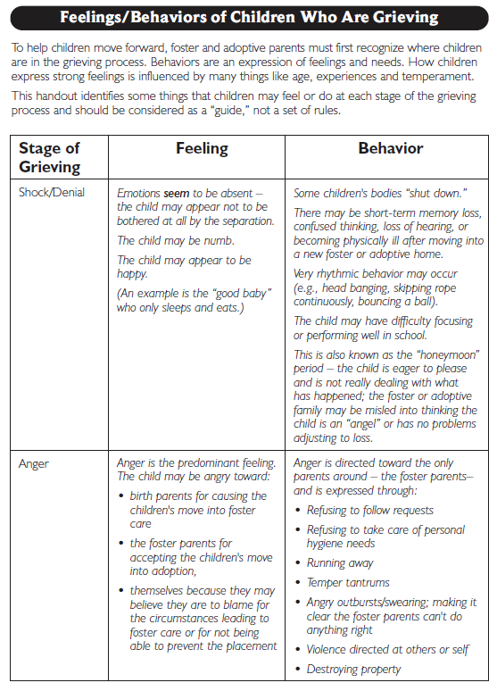
Let’s look at:
Handout 2

Slide 17
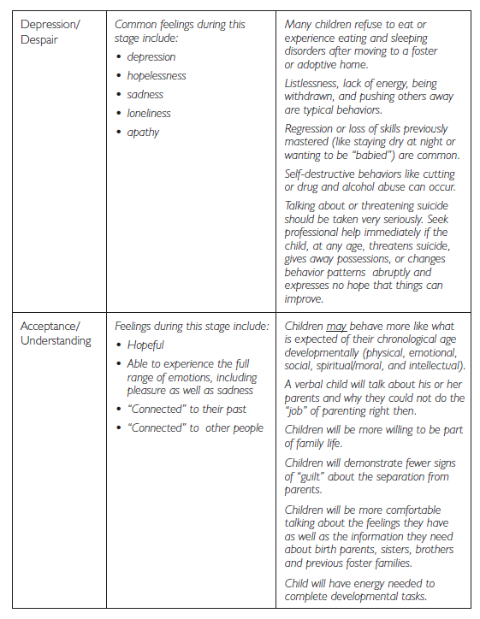

Slide 18
Lifebook
A combination of story, diary, and scrapbook that has information about a child’s life experiences, including
Pictures
Report cards
Souvenirs of special events
Medical records

Slide 19
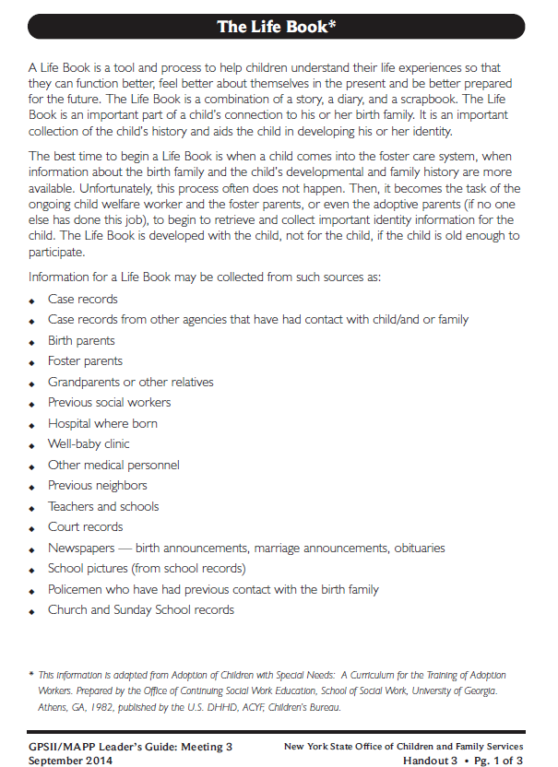
Let’s Look at:
Handout 3

Slide 20
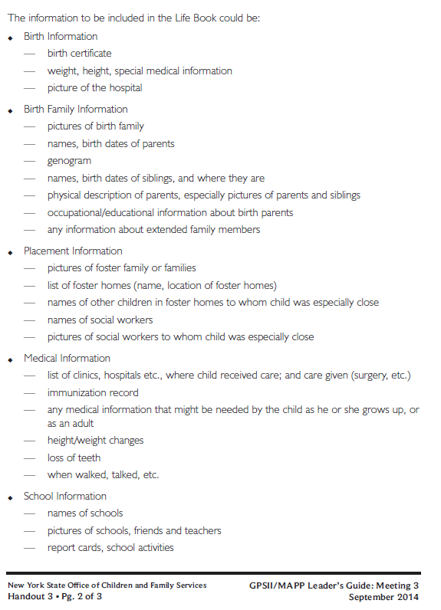

Slide 21
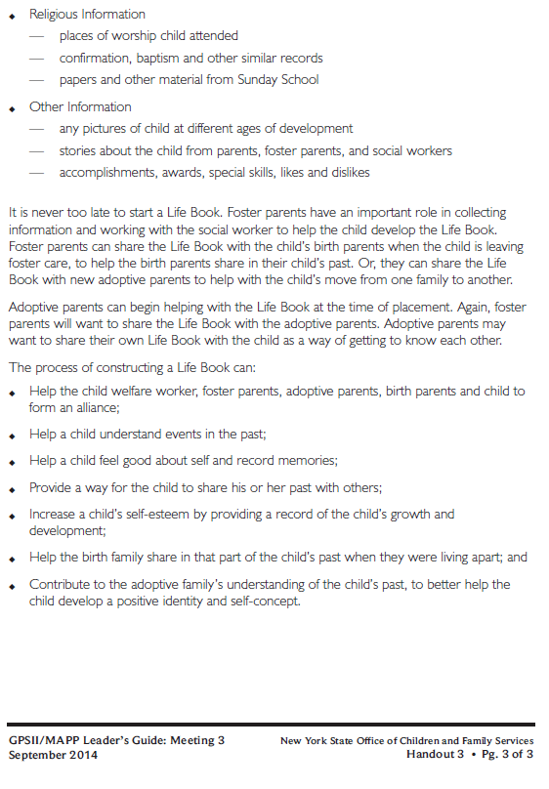

Slide 22
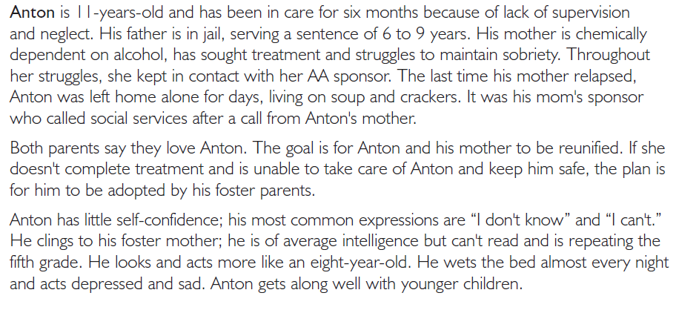
Let’s look at: Handout 4

Slide 23
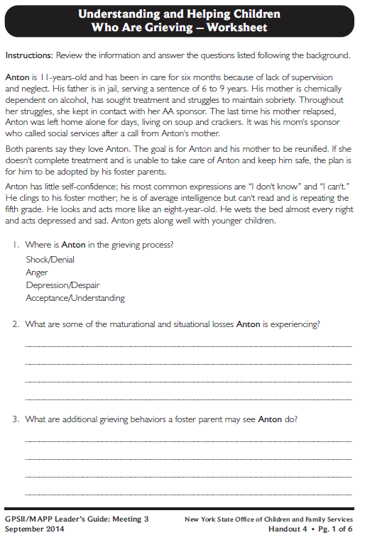
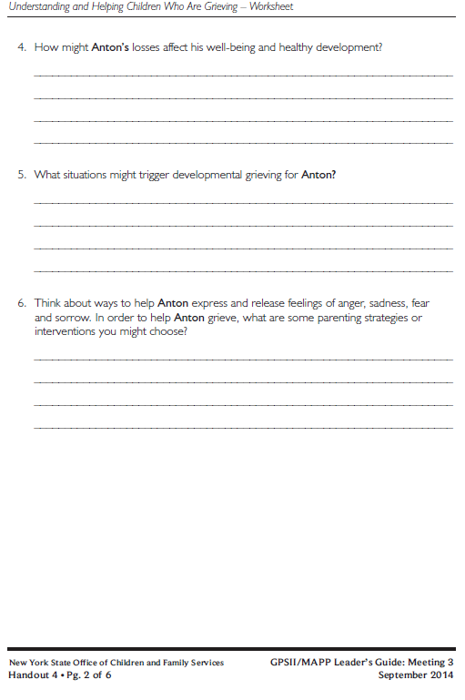

Slide 24
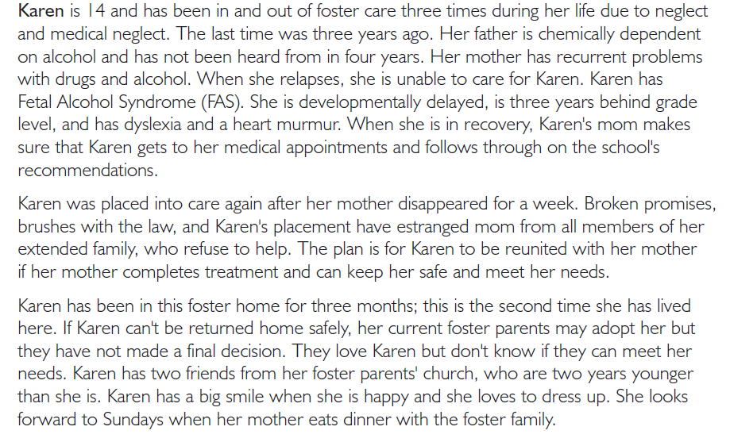
Karen

Slide 25
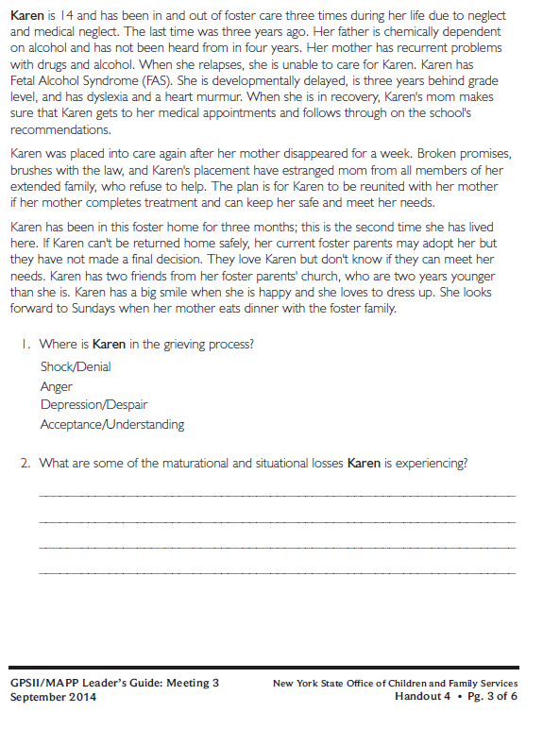
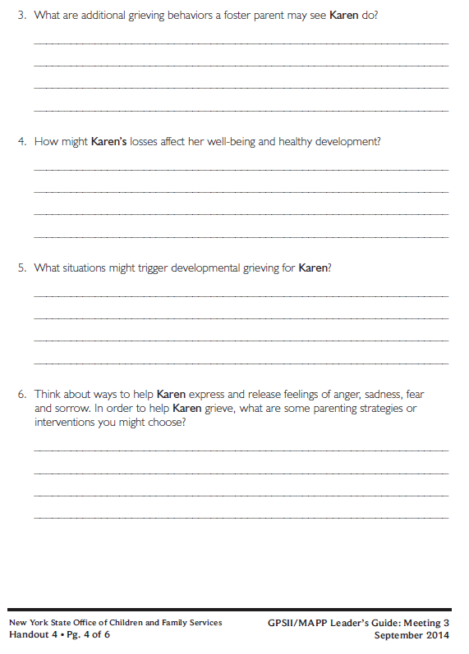

Slide 26
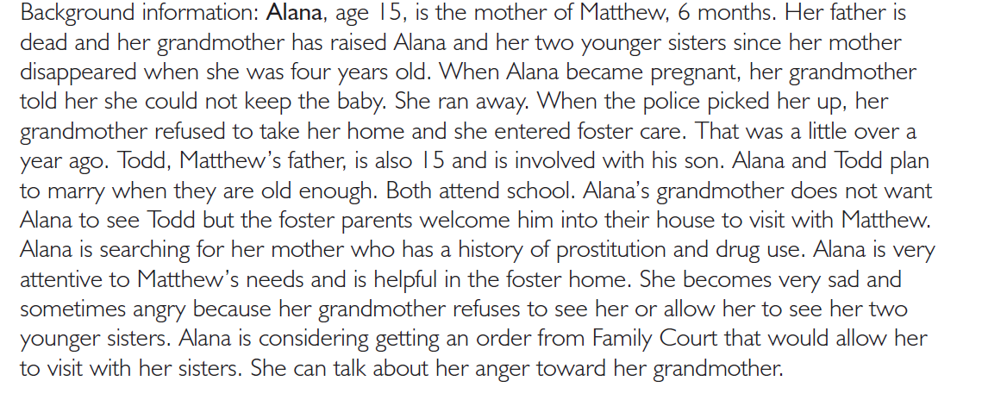
Alana

Slide 27
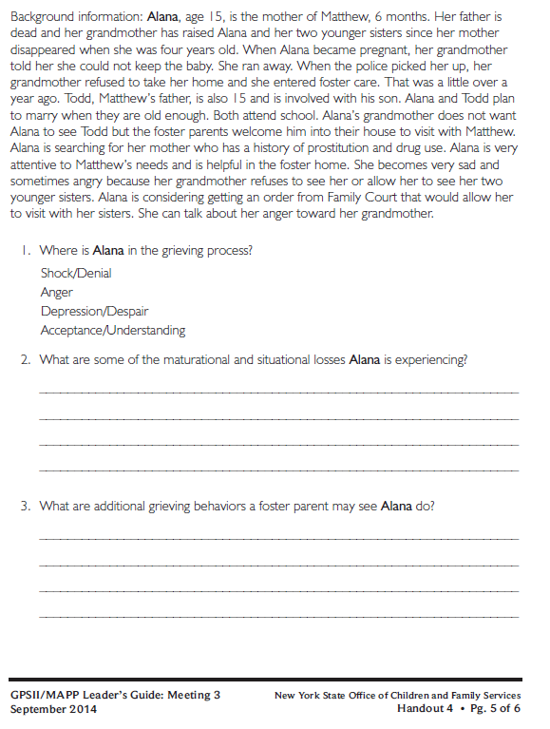
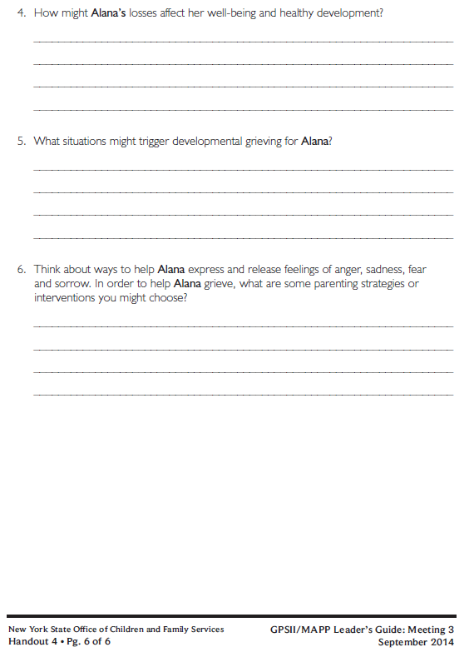

Slide 28
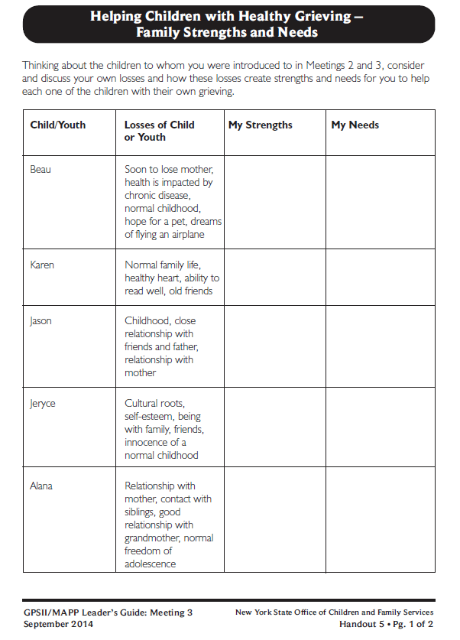
Let’s look at:
Handout 5

Slide 29
Roadwork: Complete Handout 6, “A Strengths/Needs Worksheet for Fertility Loss Experts” If Applicable to your Family

Slide 30
Roadwork Reading
Handout 7, “ Bonding and Attachment”
Handout 8, “Retrace Developmental Stages to Help Older Children Heal”
Handout 9, “An Adoptive Adolescent’s Struggle”

Slide 31
It’s Time for a PIP!
Partnership
In
Parenting Experience

